Slide 1
Distributed Dual Decomposition of Multiperiod Security-Constrained OPF

Slide 2



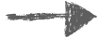
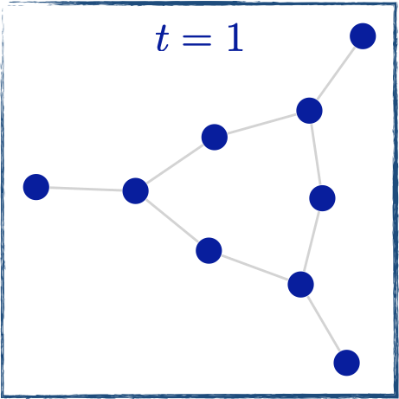
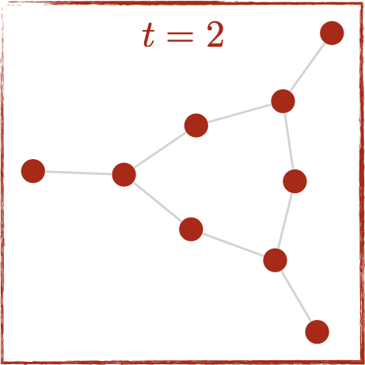
Distributed dual decomposition of AC Optimal Power Flow
We develop an optimization solver for Multiperiod Security-Constrained AC Optimal Power Flow
Novelty: we solve the problem in a parallel distributed computing environment by considering separately:
Time periods → Temporal decomposition
Contingencies → Scenario decomposition
Both time periods and contingencies
The method can scale to a very large number of time periods and scenarios in parallel
OPF in time period 1
OPF in time period 2
Ramping constraints

Slide 3
Results on PEGASE 1354 using distributed CPU
 | 10 time periods | 20 time periods | 30 time periods
Ipopt | 22 | 53 | 103
Our algorithm | 4 | 5 | 15
Next steps:
Combine temporal and scenario decomposition
Solve single-period/-scenario problems on GPU
Solution time (seconds) for convergence to 1% error in optimality and infeasibility (Ramping = 0.1%)

